Slide 1
Lake Shore High School Boys Soccer Fall 2023
Pre-Season Powerpoint

Slide 2
Contacts
Head Coach-David Lount
dlount@lsps.org
Head JV Coach-Luke Warrick
lwarrick@lsps.org

Slide 3
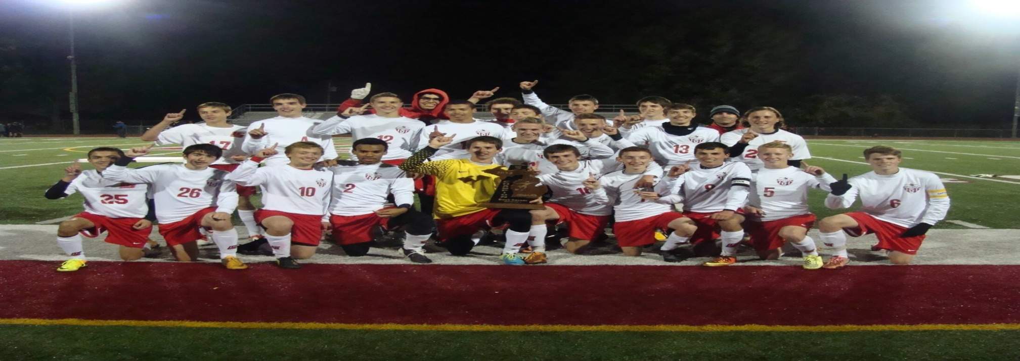
2023 LSHS BOYS SOCCER
The Lake Shore boys soccer team competes in the MAC Gold division.

Slide 4
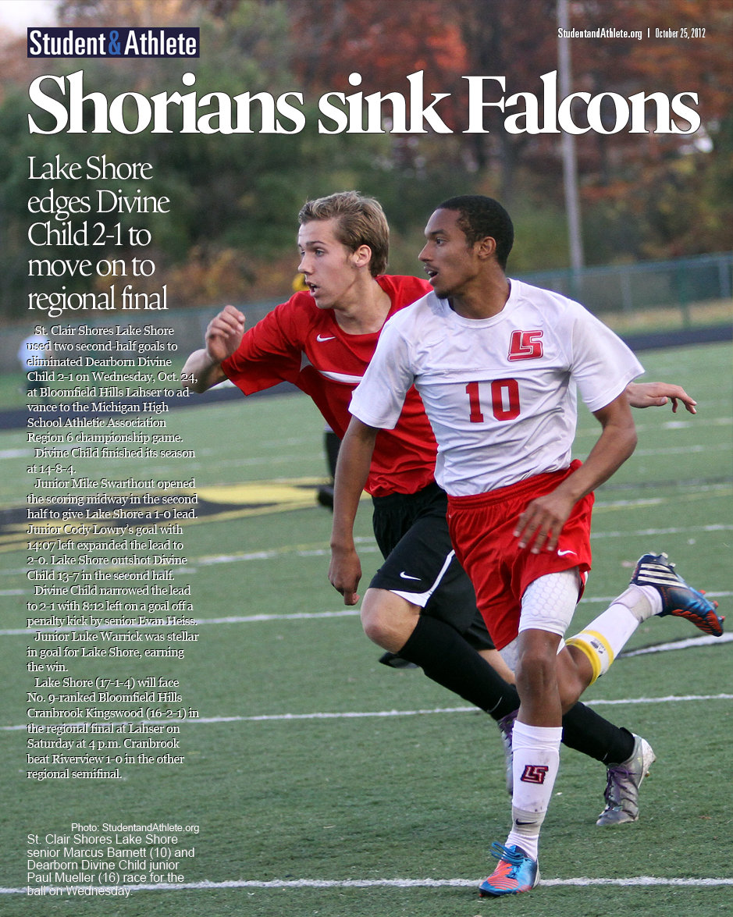
Schedules
MHSAA Athletics Page
https://www.mhsaa.com/schools/scs-lakeshore/boys/varsity/soccer
MAC Page
http://macombmac.misd.net/
LSHS Soccer Website
http://shoriansoccer.weebly.com
Please check the website, regularly.
Also check/ download team app

Slide 5
TRANSPORTATION
Transportation will be one way unless schools are further than 10 miles from Lake Shore. Schools with return transportation would be Marysville, Port Huron and St. Clair.

Slide 6
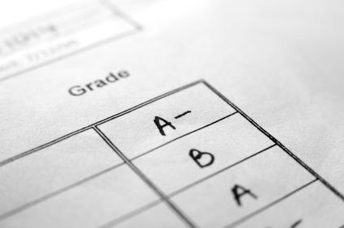
Eligibility Requirements
Academic/pass four classes
Physical on file
Meets the guidelines under the MHSAA transfer rule.

Slide 7
Behavior Expectations
Players will be respectful by using appropriate language when interacting with other players, coaches, referees, parents and spectators. Players will not taunt, use obscene gestures or attempt to demean others. HAZING WILL NOT BE TOLERATED.
Players will arrive on time, properly dressed and equipped, for all practices, games and meetings. Coaches will be notified of any irregularities, immediately.
Players will practice and exhibit good sportsmanship.
Players will use appropriate behavior on social media(twitter, etc.)

Slide 8
Team Routines
Players will remain on the bench during games, unless subbing, consulting with the trainer or warming up.
Players will report to home games 45 minutes before game time and meet at the place designated by the coach.
Players will participate as instructed during the pre-game warm-up.
Players will attend all practices properly dressed and equipped. Before the formal practice begins, players are to work on individual skills.
All equipment will be retrieved and all litter removed at the end of all games and practices. This responsibility belongs to everyone.

Slide 9
Consequences for Violating Team Rules
1st Offense: Verbal Warning
2nd Offense: Loss of ½ half of playing time
3rd Offense: Loss of a game and meeting with parents
4th Offense: Referral to Athletic Director
5th Offense: Possible removal from the team
Any players who refuse to accept consequences for their behavior will be denied participation in the program, until the conflict is resolved. All team rules are in addition to all School and District policies.

Slide 10
Absences
If you are absent for school, you cannot participate the game that day.
If you skip school- you will sit the next game
If you skip practice – you will sit the following game.
If a player has multiple absences (practice or school) we will have a meeting with AD/Coach/Parent.

Slide 11
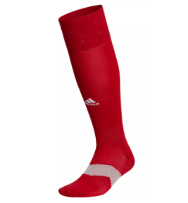
TEAM APPAREL
All players will receive shorts, two jerseys and a team bag. These are school property and are only to be worn for Lake Shore Soccer Games.
The only piece of clothing players must purchase are two pairs of team socks. One ALL WHITE pair of Adidas socks and one red pair of Adidas socks. Adidas Metro 6 sock is at any store(Dick’s, Meijer, Amazon). Team spirit wear and other gear can be purchased but IS NOT REQUIRED!

Slide 12
Follow Shorian Soccer
Follow updates to the boys soccer team by using Remind. Text @lshsso to 81010 to sign up.
http://www.macombmac.misd.net/
Twitter @shoriansoccer
www.shoriansoccer.weebly.com
Info also at team app. Download team app and search for lake shore soccer

Slide 13
Fundraiser
Kroger Fundraiser
Team Fundraiser???
Concessions
Parent contact for Athletic Boosters
Ball Boys or siblings?

